Slide 1
RELATIVISTIC QUANTUM INFORMATION PROCESSING
WITH MOVING CAVITIES
Ivette Fuentes
University of Nottingham

Slide 2
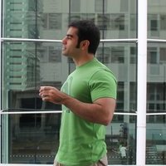
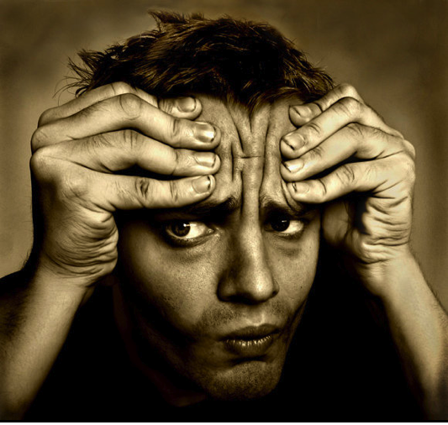
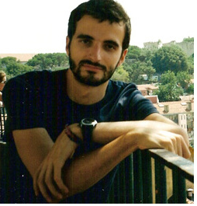
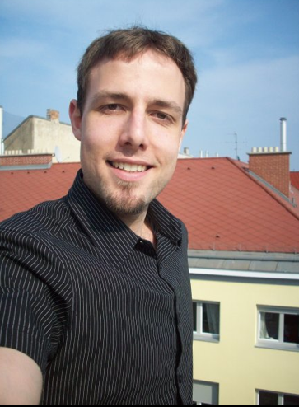
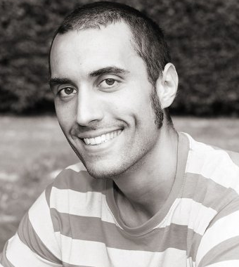
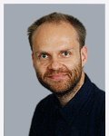
http://rqinottingham.weebly.com/
relativistic quantum information and metrology
postdocs
Mehdi Ahmadi
Jason Doukas
Andrzej Dragan (now in Warsaw)
Carlos Sabin
Angela White
PhD students
Nicolai Friis
Antony Lee
Luke Westwood
project student
Kevin Truong
collaborators
David Bruschi (Leeds)
Tony Downes (Queensland)
Daniele Faccio (Herriot-Watt)
Marcus Huber (Bristol/Barcelona)
Göran Johansson (Chalmers)
Jorma Louko (Nottingham)
Enrique Solano (Bilbao)
Tim Ralph (Queensland)
Silke Weinfurtner (SISSA, Trieste)
FUNDING: EPSRC (THANKS!!!!)

Slide 3
relativistic quantum information
INFORMATION THEORY
computation
communication
CNOT
REAL
WORLD
EXPERIMENTS
superposition
entanglement
causality
geometry
QUANTUM PHYSICS
RELATIVITY

Slide 4
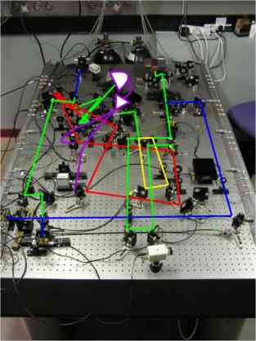
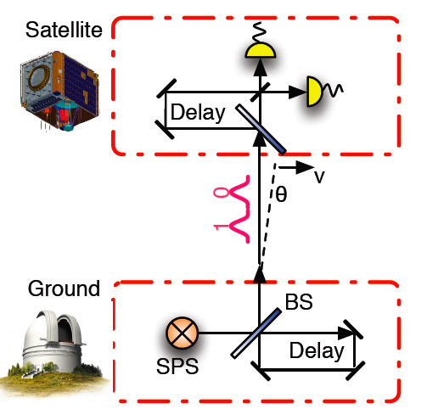
real world experiments
quantum communication
spacebased experiments
Rideout, et. al. arXiv:1206.4949
PHOTONS HAVE NO NON-RELATIVISTIC APPROXIMATION

Slide 5
relativistic quantum information
information in a relativistic quantum world
cavities
detectors
localized wave-packets
gravity effects on quantum properties
get real: earth-based and space-based experiments

Slide 6
entanglement
entangled pair

Slide 7
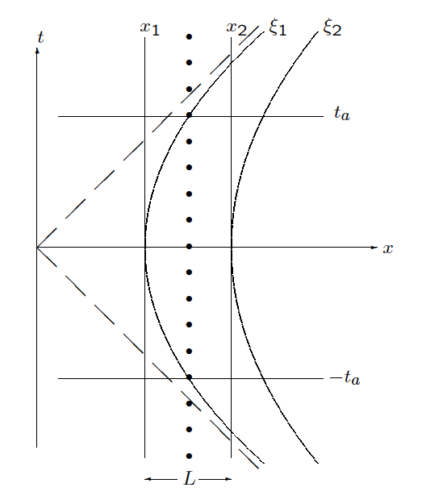
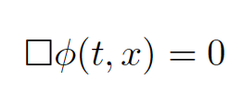
inertial cavity
Minkowski coordinates
field equation
solutions: plane waves+ boundary
creation and annihilation operators

Slide 8
uniformly accelerated cavity
Rindler coordinates
Klein-Gordon takes the same form
Bogoliubov transformations

Slide 9
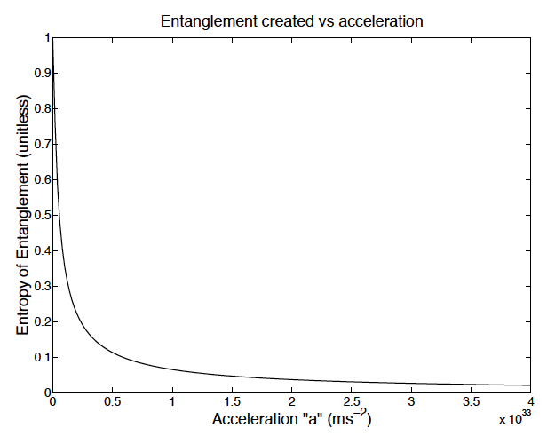
entangling moving cavities in non-inertial frames
Downes, Fuentes & Ralph PRL 2011
results
ability to entangle: depends on acceleration
idea
entanglement preserved:
inertial or uniform acceleration motion
entangle two cavities:
one inertial and one accelerated

Slide 10
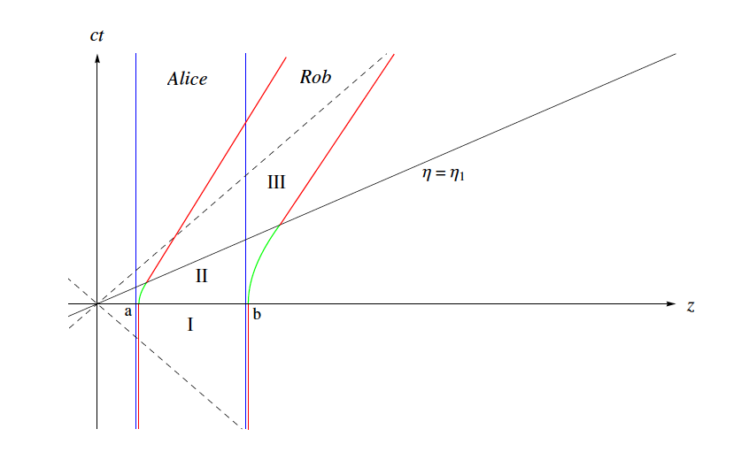
non-uniform motion
Bruschi, Fuentes & Louko PRD (R) 2011
Bogoliubov transformations
acceleration length
computable transformations

Slide 11
covariance matrix formalism
covariance matrix: information about the state
symplectic matrix: evolution
computable measures of bipartite and multipartite entanglement

Slide 12
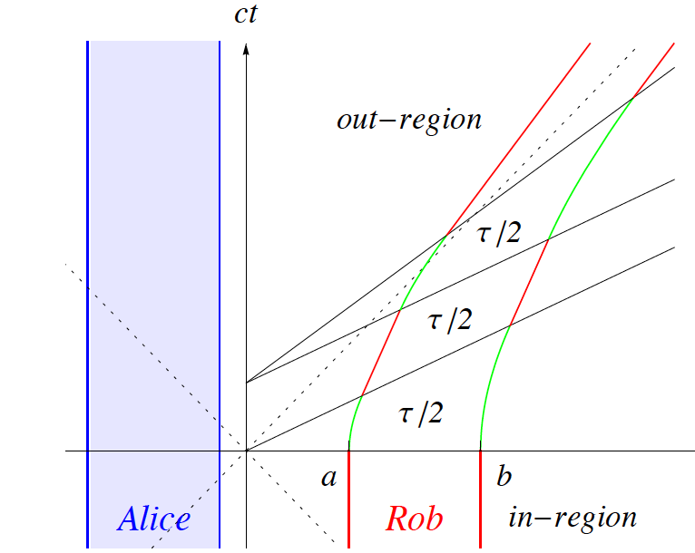
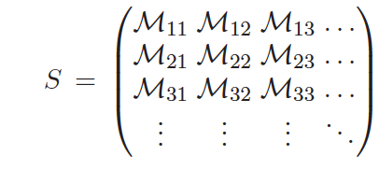
general trajectories
Friis and Fuentes JMO (invited) 2012
general symplectic matrix

Slide 13
entanglement generated
Friis, Bruschi, Louko & Fuentes PRD 2012
Friis and Fuentes JMO 2012
Bruschi, Louko, Faccio & Fuentes 2012
general trajectories
continuous motion
including circular acceleration
initial separable squeezed state
entanglement: negativity

Slide 14
motion and gravity create entanglement
Friis, Bruschi, Louko, Fuentes PRD (R) 2012
results
non-uniform motion creates entanglement
gravity creates entanglement
single cavity

Slide 15
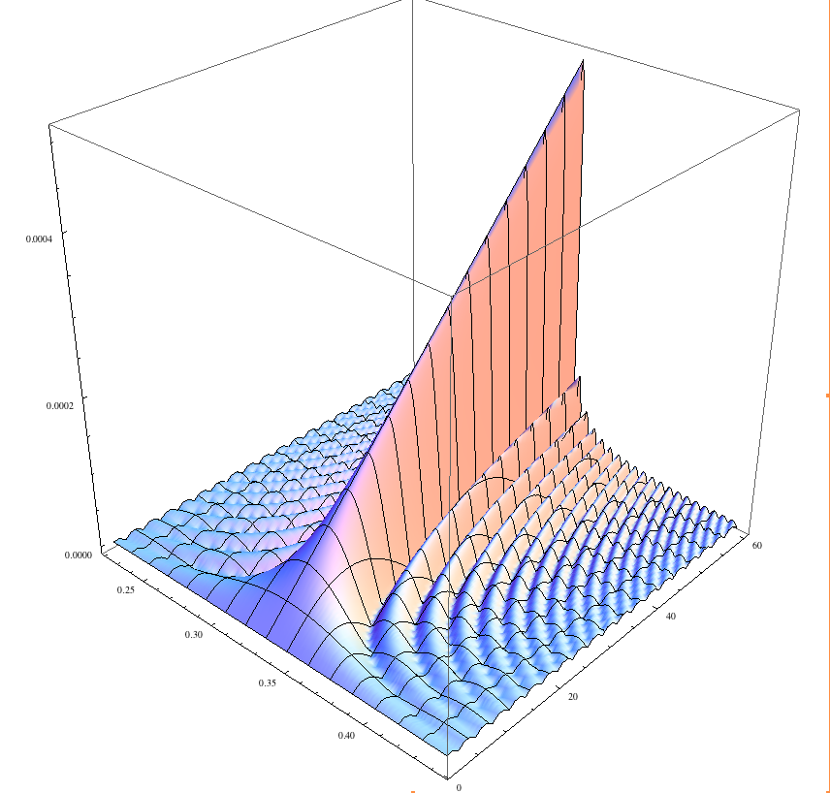
entanglement resonances
Bruschi, Lee, Dragan, Fuentes, Louko arXiv:1201.0663
Bruschi, Louko, Faccio & Fuentes 2012
entanglement resonance
total segment time
amount of entanglement
trajectory details
Also: entanglement resonance without particle creation
observable by mechanical means
Entanglement vs.
number of oscillations and
period of oscillation

Slide 16
quantum gates
Friis, Huber, Fuentes, Bruschi PRD 2012
Bruschi, Lee, Dragan, Fuentes, Louko arXiv:1201.0663
Bruschi, Louko, Faccio & Fuentes 2012
the relativistic motion of
quantum systems can be used
to produce quantum gates
two-mode squeezer
beam splitter
multi-qubit gates:
Dicke states
Multi-mode squeezer

Slide 17
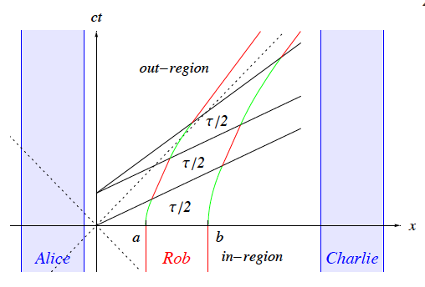
multipartite case
Friis, Huber, Fuentes, Bruschi PRD 2012
resonance:
dates creating Dicke states
Entanglement: genuine multipartite entanglement created

Slide 18
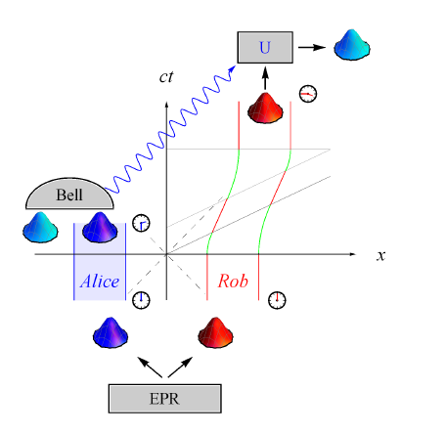
teleporation with an accelerated partner
Friis, Lee, Truong, Sabin, Solano, Johansson & Fuentes 2012
the fidelity of teleportation is effected by motion
it is possible to correct by local rotations and trip planning

Slide 19
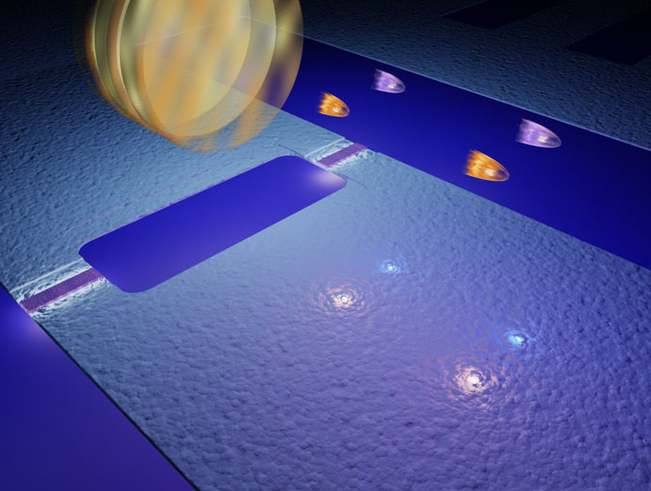
new directions: experiments
Friis, Lee, Truong, Sabin, Solano, Johansson & Fuentes 2012
Art by
Philip Krantz
(Chalmers)
simulate field inside a cavity which travels in a spaceship using superconducting circuits
To infinity and beyond…….

Slide 20
Thank you

